Slide 1
Differential Industry Responses to Monetary Policy in the Zero Lower Bound Era
Brock Kelly
ECON 492 – Empirical Paper in Macroeconomics
Fall 2020

Slide 2
Table of Contents
Title
Table of Contents
Introduction
Purpose
Concept Review
6-8. Literature Review
“Differences in Industry Responses to Monetary Policy Shocks” (Javier Nieto, 2016)
“The Monetary Transmission Mechanism; Evidence from five OECD Countries” (Dedola and Lippi, 2000)
Shadow Rate and Shadow Policy Rate (Wu-Xia, 2016), (Lombardi and Zhu, 2014)
9-11. Methods
Data and Limitations
Development of Measures
Regressions
12-16. Results
Aggregate Effects
Energy
Industrials
Real Estate
Financials
17-20. Conclusions
Accuracy of Measures
Issues
Final Remarks

Slide 3
Introduction
The effect of monetary policy is one of the most commonly research topics in economics and has become increasingly relevant since the financial crisis of 2008.
The low-inflation, low-interest rate environment that has prevailed since the early 1980s has resulted in limitations on traditional expansionary monetary policy due to the presence of the Zero-Lower Bound.
This led to the adoption of unconventional methods of monetary policy, most prominently quantitative easing (QE) and forward guidance (FG).
I will analyze the effect of these methods as well as more traditional tools on a per-industry basis since 2008.

Slide 4
Purpose
In my analysis, I will attempt to answer a few key questions about monetary policy in the post-2008 era.
What effect have these new tools had on industry fundamentals compared to more traditional tools?
Are these results consistent with our intuition of the channels of monetary transmission as defined by previous studies?
What further conclusions can be drawn from these results?
The basis for answering these questions will be the response of aggregate industry revenue and equity prices to various measures of monetary shocks.

Slide 5
Concept Review
Federal Funds Rate
Intended Federal Funds Rate – Fed’s target rate at which depository institutions can borrow or lend excess reserves.
Effective Federal Funds Rate – The prevailing average rate at which depository institutions actual carry out these transactions.
Traditional tool of monetary policy.
Quantitative Easing
Has many definitions depending on the country in which it was employed.
Federal Reserve Chairman Ben Bernanke (2006-2014) – “the large-scale purchase of longer-term financial assets by central banks “ (Bernanke, 2020).
Large-Scale Asset Purchases – Purchase of treasury securities, mortgage-backed securities, and corporate bonds in order to influence the term-structure of interest rates across a variety of asset classes.
Influence of Excess Reserves – Another goal of QE is the direct influence of the level of excess reserves with idea that these excess reserve will naturally spill out into the rest of the economy through sheer size alone (Vissing-Jorgensen & Krishnamurthy, 2011).
Forward Guidance
Based on rational-expectations theory (Bernanke, 2020).
Federal Reserve’s traces path of future short-term interest rates.
During the financial crisis, the Fed announce the intention to keep interest rates low for an extended period, pushing long-term rates down.

Slide 6
“Differences in Industry Responses to Monetary Policy Shocks” (Javier Nieto, 2016)
Purpose
Examine the different responses of various industries in terms of revenue, profit, equity prices, and intrinsic valuation to monetary shocks.
Methods
Employed a measure of monetary shocks developed by Romer and Romer (2004).
Conclusions
Found a “large, persistent, and statistically significant (negative) effect on total output and profits”
”Clear sectoral differences in the way monetary policy effects the different industries that make up the U.S. economy.
Energy, industrials, semiconductors, and real estate are among the most sensitive to contractionary monetary policy.
13 out 26 industries showed statistically significant negative stock returns on the day of the FOMC announce of contractionary monetary policy.
Several factors influence the sensitivity of industries to contractionary monetary shocks including capital intensity, degree of openness, relative risk of default, and primary method of financing.

Slide 7
“The Monetary Transmission Mechanism; Evidence from five OECD Countries” (Dedola and Lippi, 2000)
Purpose
Examined the cross-industry effects of monetary policy.
Explore the mechanism of transmission through which monetary policy effects industry output.
Methods
Used firm-level and a SVAR(5) controlling for key macroeconomic variables and imposing an order of transmission.
Used results to develop impulse response functions for industry output using the effective exchange rate as the impulse.
Conclusions
Found “significant heterogeneity of policy effects”.
Strong correlation between industry response and measures such as durability of goods produced, investment intensity, borrowing capacity, and interest payment burden.

Slide 8

“A New Measure of Monetary Shocks: Derivation and Implications” Romer and Romer (2004)
Purpose
To develop a measure of monetary shocks that is exogenous from “systematic responses to information about future developments”.
Methods
Used FOMC meeting records to separate the intended and unexpected effects of rate-setting decisions.
The measure of monetary shock is defined as the error term of the following regression.
$Δintff=α+βintff+\sum_{i=−1}^{2}{y_{i}\tilde{Δy_{mi}}+\sum_{i=1}^{2}{λ_{i}(}}\tilde{Δy_{mi}−}\tilde{Δy_{m−1,i}})+\sum_{i=1}^{2}{φ_{i}}\tilde{Δπ_{mi}}+\sum_{i=1}^{2}{θ_{i}(}\tilde{Δπ_{mi}−}\tilde{Δπ_{m−1,i}})+ρ\tilde{u_{m0}}+ε_{m}$
Here we can see the change in the intended federal funds rate regressed onto
The previous level of the intended federal funds rate: $intff$
The previous, current, and future projections of GDP growth and inflation: $\tilde{Δy_{mi}} ,\tilde{ Δπ_{mi}}$
The change from the previous quarter in the previous, current, and future projections of GDP growth and inflation: $\left(\tilde{Δπ_{mi}−}\tilde{Δπ_{m−1,i}}\right) , \tilde{(Δy_{mi}−}\tilde{Δy_{m−1,i})}$
The current unemployment forecast: $u_{m0}$
Conclusions
Found statistically significant effects on key macroeconomic variables, more so than the effect of traditional indicators over the 1969-1996 period.

Slide 9
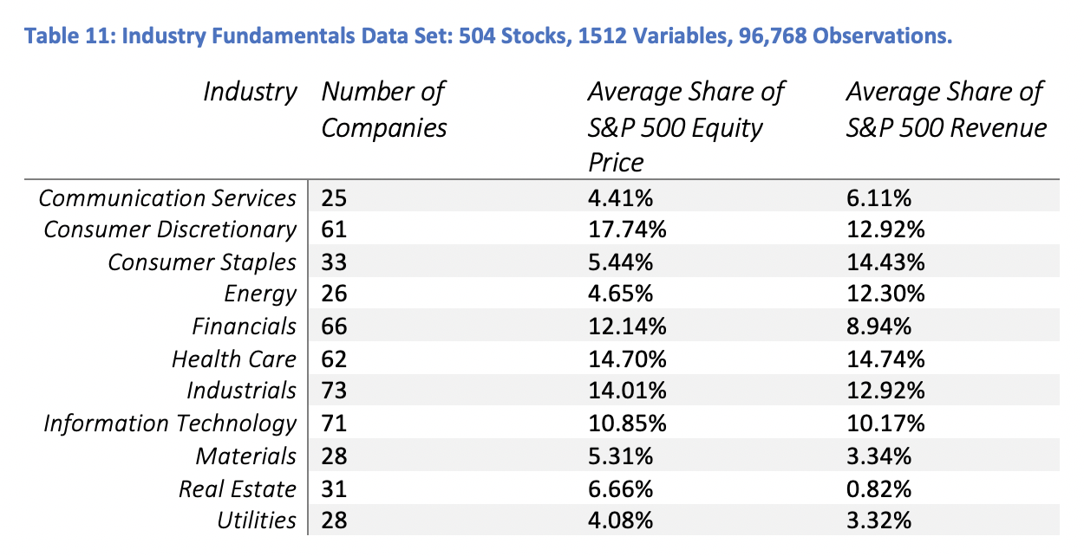
Methods: Data and Limitations
Collected from WRDS and FRED.
Revenue and Average Monthly Return for every company in the S&P 500, aggregated by GICS Sector.
Period: 2005q1 – 2020q4 (included 12 previous observations for lag observations).
This is not the largest data set that we could have used; 500 companies, ~45 companies per sector, not expecting to find statistically significant results (different from 0).

Slide 10
Methods: Development of Monetary Shocks
Looked at 5 different measures of monetary shocks.
Dedola and Lippi’s method employs a VAR(5) and using the effective federal funds rate as the shock (not shown here).
Romer and Romer / Javier Nieto’s method employs an exogenous measure of monetary shocks constructed using contemporaneous FOMC estimates of key macroeconomic variables.
Wu-Xia Shadow Rate is a measure of how interest rates would have reacted in the absence of the ZLB. This means that that reductions In interest rates below 0 are just as effective as before.
Our measure of QE/LSAP is constructed in the same way as Romer and Romer, except by treating the size and asset makeup of the Fed’s balance sheet as a policy tool of the fed, we can substitute it for the intended federal funds rate.
Our measure of forward guidance is loosely based on Lombardi and Zhu’s measure in which the used the spread between the 3-month LIBOR and US Treasury Bill as an indicator of the future path of short-term interest rates. We will once again treat this as a policy tool of the Fed and substitute it for the intended federal funds rate in the same manner as before.

Slide 11
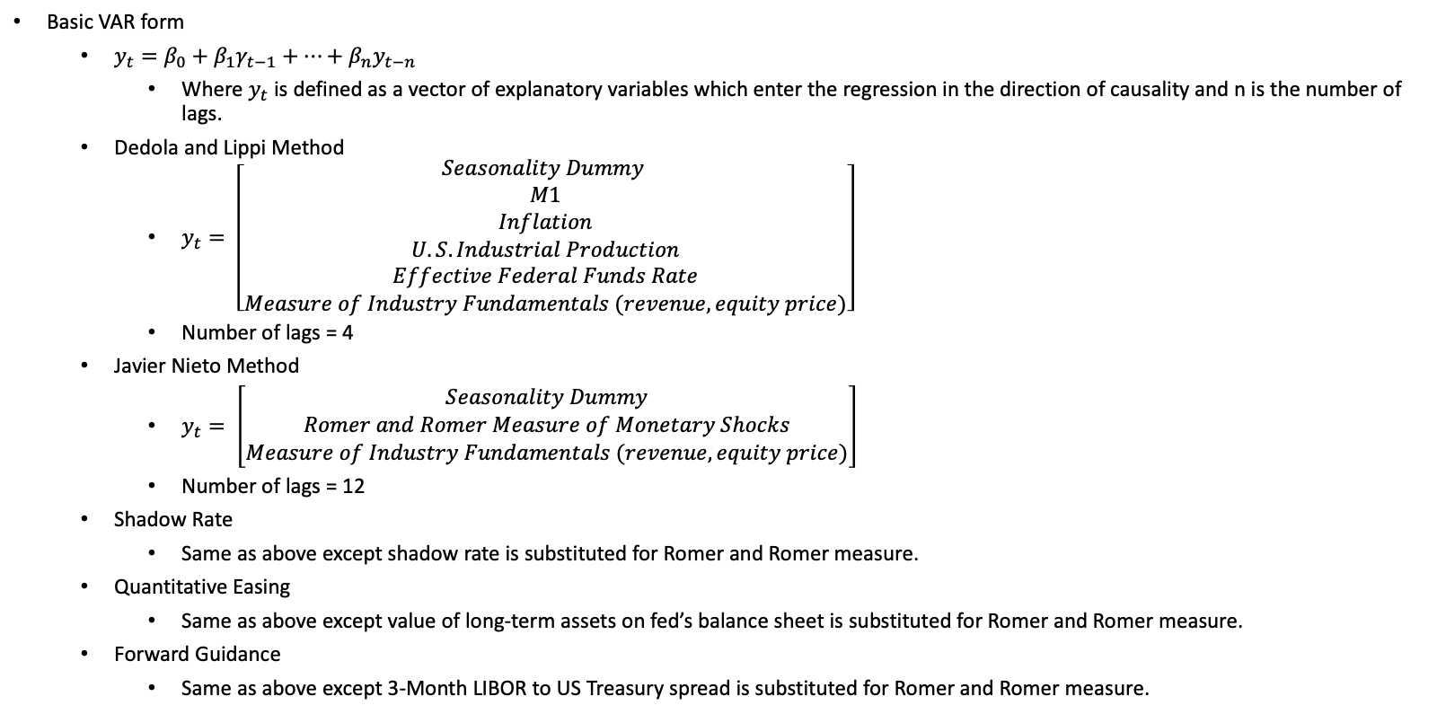
Methods: Regressions
Basic VAR form
$y_{t}=β_{0}+β_{1}γ_{t−1}+…+β_{n}y_{t−n}$
Where $y_{t}$ is defined as a vector of explanatory variables which enter the regression in the direction of causality and n is the number of lags.
Dedola and Lippi Method
$y_{t}= \left[\begin{aligned}Seasonality Dummy \\ M1 \\ Inflation \\ U.S. Industrial Production \\ Effective Federal Funds Rate \\ Measure of Industry Fundamentals (revenue, equity price)\end{aligned}\right]$
Number of lags = 4
Javier Nieto Method
$y_{t}= \left[\begin{aligned}Seasonality Dummy \\ Romer and Romer Measure of Monetary Shocks \\ Measure of Industry Fundamentals (revenue, equity price)\end{aligned}\right]$
Number of lags = 12
Shadow Rate
Same as above except shadow rate is substituted for Romer and Romer measure.
Quantitative Easing
Same as above except value of long-term assets on fed’s balance sheet is substituted for Romer and Romer measure.
Forward Guidance
Same as above except 3-Month LIBOR to US Treasury spread is substituted for Romer and Romer measure.

Slide 12
Results: Total
Very few trends that are statistically significant from 0 after 12 quarters.
252 of 500 companies are in sectors that are theoretically unsensitive to interest rate changes.
Effect of unconventional methods are more statistically significant.

Slide 13
Results: Energy
Contractionary monetary policy had a strong negative effect on energy sector fundamentals.
Expansionary QE and forward guidance had strong, and statistically significant effects on energy sector fundamentals.
Energy was the most responsive to monetary policy shocks out of the industries we observed.
This is likely due to two factors; capital-intensity and exchange rate sensitivity.
Capital intensity – decrease in new investment and increasing costs of interest rate payments on previous debt-financed investment.
Exchange rate sensitivity – increase in interest rates results in the appreciation of the US dollar which decreases the demand for US energy products.
Energy responded as expected in 9 out of 10 measures (β = 0.9) with the only exception being the response of revenue to the Romer EFFR Shock.
β = Sign Test-Statistic
β = 1 if response is consistent with our intuition.
Method / Shock | Revenue (β) | Price (β)
Dedola and Lippi / EFFR | -21.0% (1) | -45.5% (1)
Nieto and Romer / Exogenous EFFR Shock | 10.3% (0) | -75.1% (1)
Nieto and Romer / Exogenous Shadow Rate Shock | -15.2% (1) | -72.5% (1)
Nieto and Romer / Exogenous LSAP Shock | 232.2% (1) | 289.1% (1)
Nieto and Romer / Exogenous Forward Guidance Shock | 37.8% (1) | 36.7% (1)

Slide 14
Results: Industrials
Effect on industrials is more muted, yet more consistent than that on the energy sector.
Effect is consistent with our intuition of the effect of monetary shocks across all measures (β = 1).
4 out of 10 of these results were statistically significant.
Industrials: Capital intensive and producers of relatively durable goods.
The transmission mechanism of monetary shocks in producers of durable goods can be described by a sticky price dynamic factors model (Yun, 1996).
Nominal price rigidity, which can be approximated by the number of times firms typically/could adjust their prices, affects an industry’s ability to react to external price changes such as a monetary policy.
They are thus more sensitive to interest rate shocks (Dedola and Lippi, 2000)
Method / Shock | Revenue (β) | Price (β)
Dedola and Lippi / EFFR | -21.0% (1) | -45.5% (1)
Nieto and Romer / Exogenous EFFR Shock | 10.3% (0) | -75.1% (1)
Nieto and Romer / Exogenous Shadow Rate Shock | -15.2% (1) | -72.5% (1)
Nieto and Romer / Exogenous LSAP Shock | 232.2% (1) | 289.1% (1)
Nieto and Romer / Exogenous Forward Guidance Shock | 37.8% (1) | 36.7% (1)
Method / Shock | Revenue (β) | Price (β)
Dedola and Lippi / EFFR | -7.92% (1) | -12.2% (1)
Nieto and Romer / Exogenous EFFR Shock | -20.3% (1) | -25.2% (1)
Nieto and Romer / Exogenous Shadow Rate Shock | -10.9% (1) | -3.7% (1)
Nieto and Romer / Exogenous LSAP Shock (Expansionary) | 114.5% (1) | 93% (1)
Nieto and Romer / Exogenous Forward Guidance Shock (Expansionary) | 8.4% (1) | 9.2% (1)

Slide 15
Results: Real Estate
Typically thought of as very sensitive to monetary shocks.
Unconventional monetary policy has often targeted the real estate sector directly through the purchase of mortgage-backed securities (MBS).
Despite this we have seen that real estate appears to be more sensitive to traditional channels of monetary transmission than QE or forward guidance.
This may be a result of our QE measure failing to capture the purchase of MBS.
The real estate underperformed the S&P in its response to the shadow rate, QE, and forward guidance.
This may be indicative of a more direct influence of interest rates on the demand for real estate due to the importance of traditional interest rates on mortgage payments.
β = 0.9
Method / Shock | Revenue (β) | Price (β)
Dedola and Lippi / EFFR | -10.5% (1) | -19.6% (1)
Nieto and Romer / Exogenous EFFR Shock | -11.9% (1) | -23.1% (1)
Nieto and Romer / Exogenous Shadow Rate Shock | -1.8% (1) | -17.3% (1)
Nieto and Romer / Exogenous LSAP Shock (Expansionary) | 65.8% (1) | 56.9% (1)
Nieto and Romer / Exogenous Forward Guidance Shock (Expansionary) | 4% (1) | -2.5% (0)
Method / Shock | Revenue (β) | Price (β)
Dedola and Lippi / EFFR | -21.0% (1) | -45.5% (1)
Nieto and Romer / Exogenous EFFR Shock | 10.3% (0) | -75.1% (1)
Nieto and Romer / Exogenous Shadow Rate Shock | -15.2% (1) | -72.5% (1)
Nieto and Romer / Exogenous LSAP Shock | 232.2% (1) | 289.1% (1)
Nieto and Romer / Exogenous Forward Guidance Shock | 37.8% (1) | 36.7% (1)

Slide 16
Results: Financials
Financials are expected to perform well to contractionary monetary policy, at least in terms of revenue.
This is due to the increased spread between the rate of which they borrow from the central bank and the rate they charge their customers. If the latter stays constant, their revenue is expected to increase.
In our analysis, we found that financial revenue, moved as expected in only 3 out of 5 measures.
Equity prices and revenue moved in opposite directions in 4 out of 5 measures.
In the traditional EFFR shocks we observed an in initial significant increase in revenue, followed by a slow decline to near zero after 3 quarters.
The shadow rate had a more significant effect on revenue as can be seen above.
Method / Shock | Revenue (β) | Price (β)
Dedola and Lippi / EFFR | -2.2% (0) | 5.9% (1)
Nieto and Romer / Exogenous EFFR Shock | 5.2% (1) | -7.3% (0)
Nieto and Romer / Exogenous Shadow Rate Shock | 9% (1) | -6.1% (0)
Nieto and Romer / Exogenous LSAP Shock (Expansionary) | -12.4% (1) | 125.1% (0)
Nieto and Romer / Exogenous Forward Guidance Shock (Expansionary) | 8.6% (0) | 2.1% (0)

Slide 17

Conclusion: Accuracy of Measures
On average, the measures of unconventional monetary policy predicted responses concurrent with the transmission of monetary policy better than the methods by Dedola and Lippi and Romer and Romer.
Wu-Xia Shadow Rate
9% more accurate than Dedola and Lippi: $β_{Shadow}=0.92>0.83= β_{Romer}$
25% more accurate than Romer and Romer: $β_{Shadow}=0.92>0.67= β_{Dedola}$
Our measure of quantitative easing predicted movements aligning with our intuition in every IRF: $β_{QE}=1.$
Our measure of forward guidance predicted movements aligning with our intuition in 9 out 12 IRFs: $β_{FG}=0.75$.

Slide 18
Conclusion: Issues
It must be noted that the measure I employed of Dedola and Lippi’s method is only a rough approximation as it does not allow for all of the theoretical interactions between explanatory variables that were specified in the original paper.
Another issue is in the construction of our measures of QE and forward guidance, we did not control for the effective exchange rate.
Since these decisions are often made simultaneously, we have not controlled for the effects of hidden policy variables.
Therefore, when we look at the effects of QE and forward guidance, we will only consider whether the direction of change aligns with our intuition (β).
All measures met stationarity conditions but some failed stability conditions, indicating the possibility of divergence.

Slide 19
Conclusion
Unconventional methods have similar directional effects on industry fundamentals as more traditional models.
Unconventional measures are more accurate at predicting these responses. This has been proven on a macroeconomic scale in previous studies, but this extends it to a per-industry basis.
Our results are very comparable to the previous studies we mentioned.
Our results provide support for the traditional channels of transmission of interest rates, yet we cannot determine the relative strength of capital-intensity, durability of goods, exchange rate sensitivity in the final results.

Slide 20
References
Bernanke, B. S. (2020). The New Tools of Monetary Policy: American Economics Association. Presidential Address. 57.
Vissing-Jorgensen, A., & Krishnamurthy, A. (2011). The Effects of Quantitative Easing on Interest Rates. Brookings Papers on Economic Activity, 2. https://doi.org/10.2139/ssrn.1784270

